Slide 1

BASIC ELECTRICAL AND ELECTRONICS ENGINEERING
Course Code: CSE1002
SCHOOL OF COMPUTER SCIENCE ENGINEERING AND APPLICATIONS
Mrunmayee Rahate
Assistant Professor, DYPIU

Slide 2
Module 2: Semiconductor Devices and Applications
Lecture 4: Clipper, Clamper Circuits

Slide 3
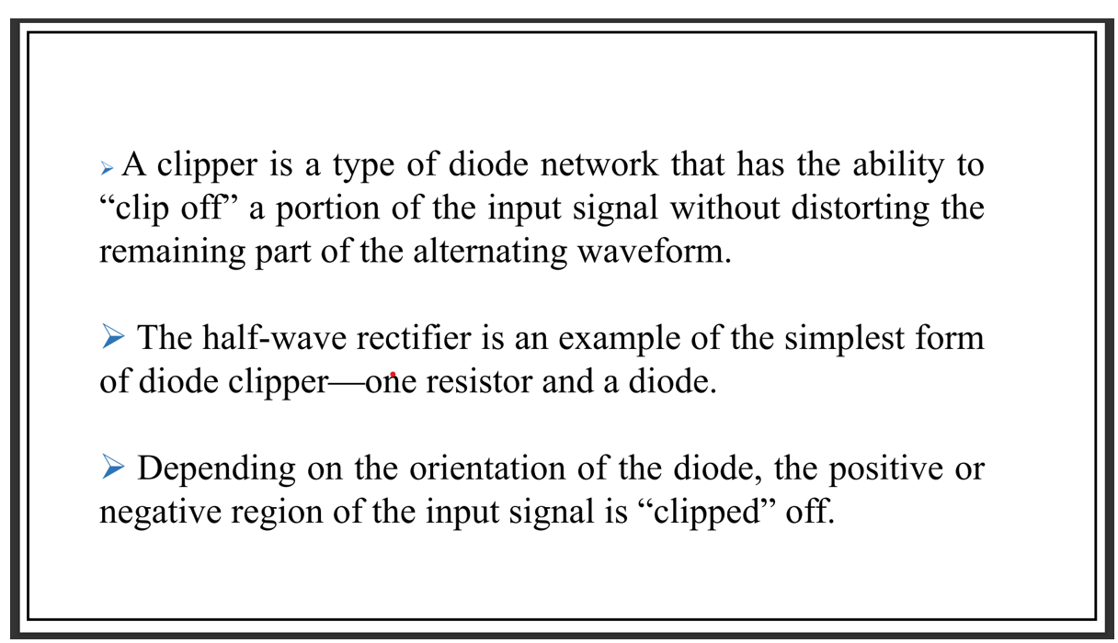
Clipper

Slide 4
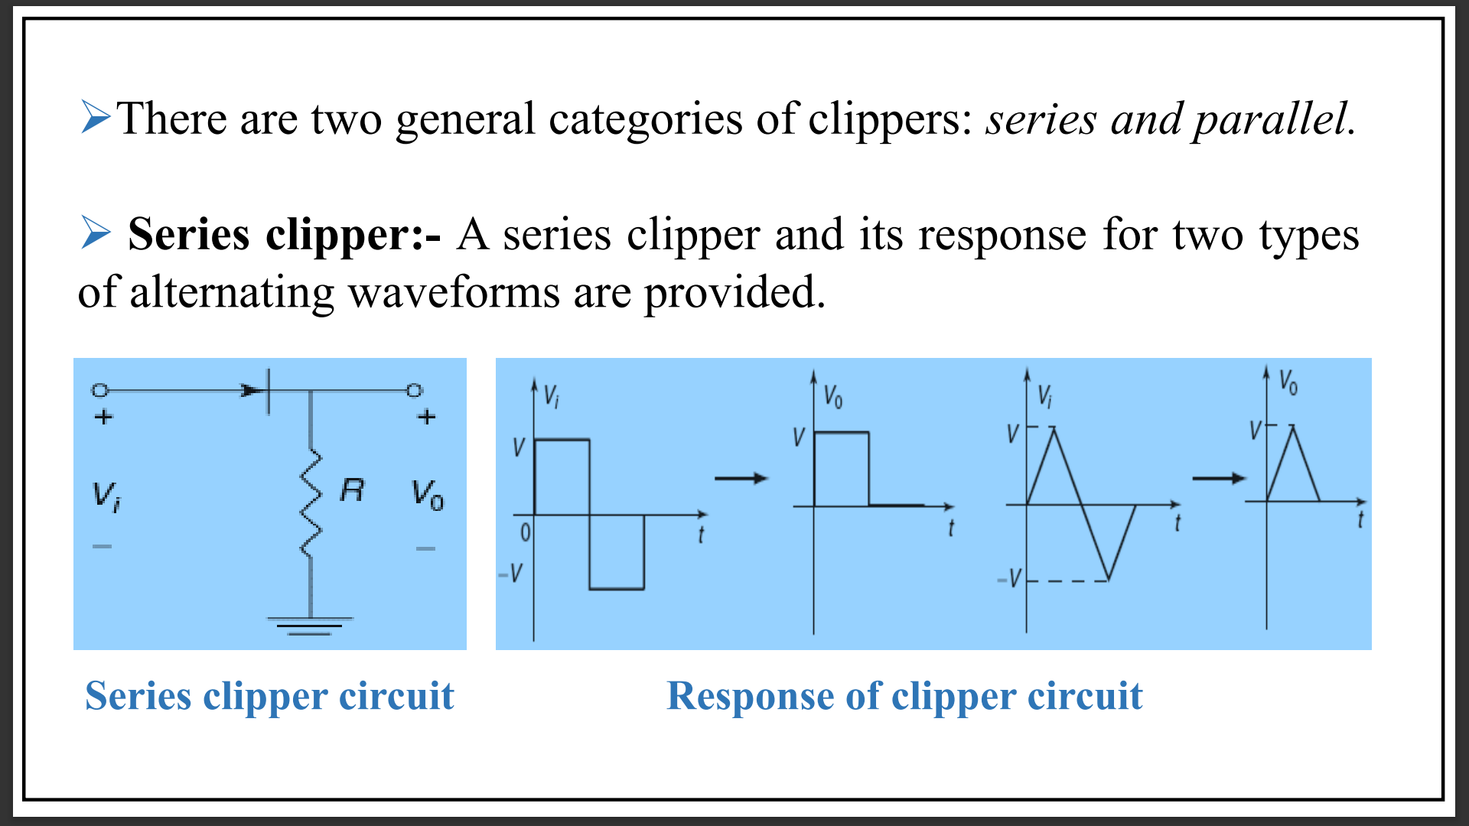
Series Clipper

Slide 5
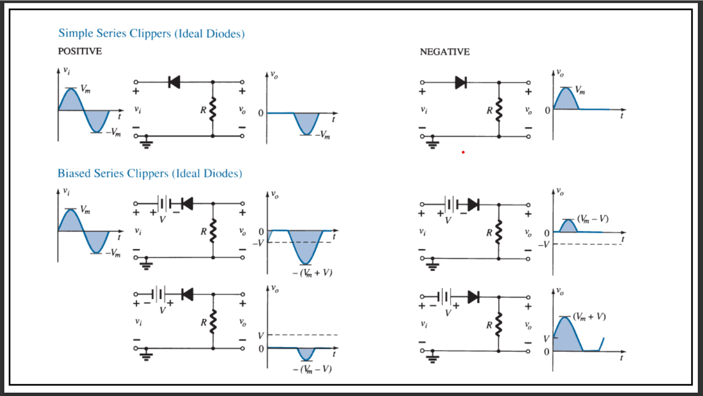
Series Clipper

Slide 6
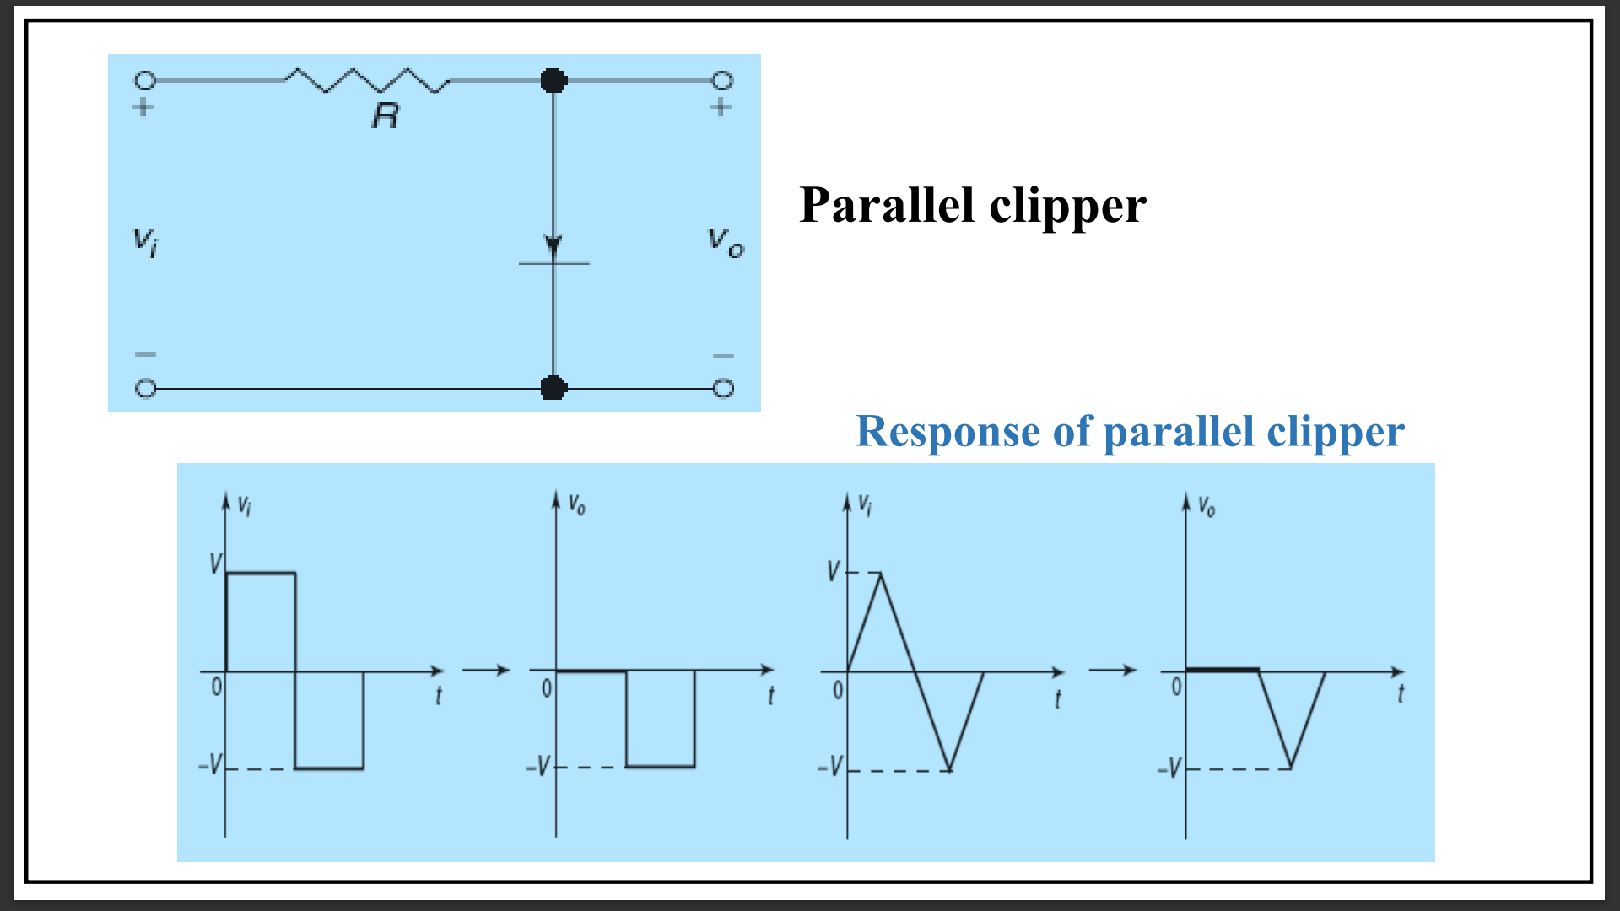
parallel Clipper

Slide 7
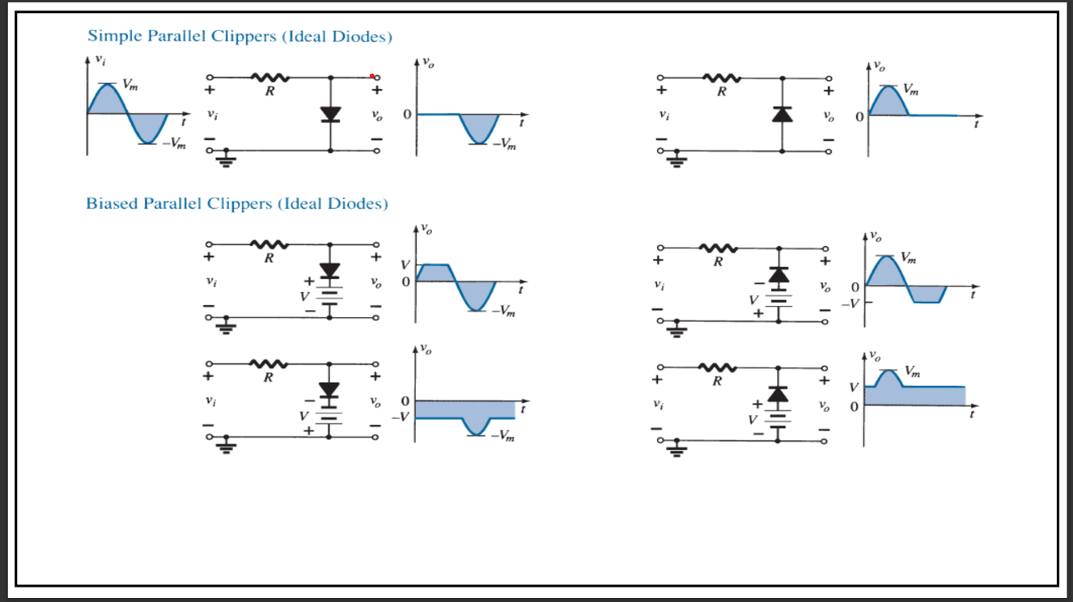
Parallel Clipper

Slide 8
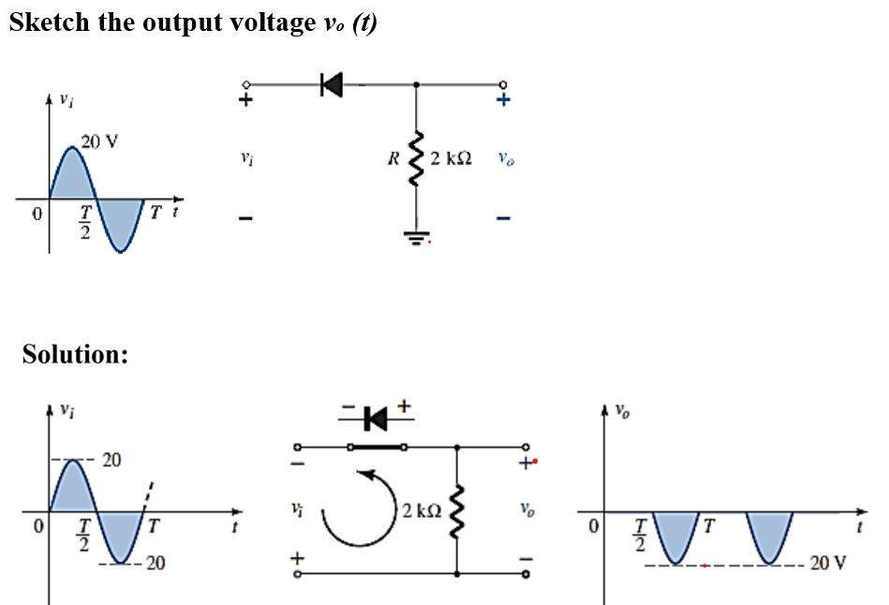
Clipper - numerical

Slide 9
Clipper - numerical

Slide 10
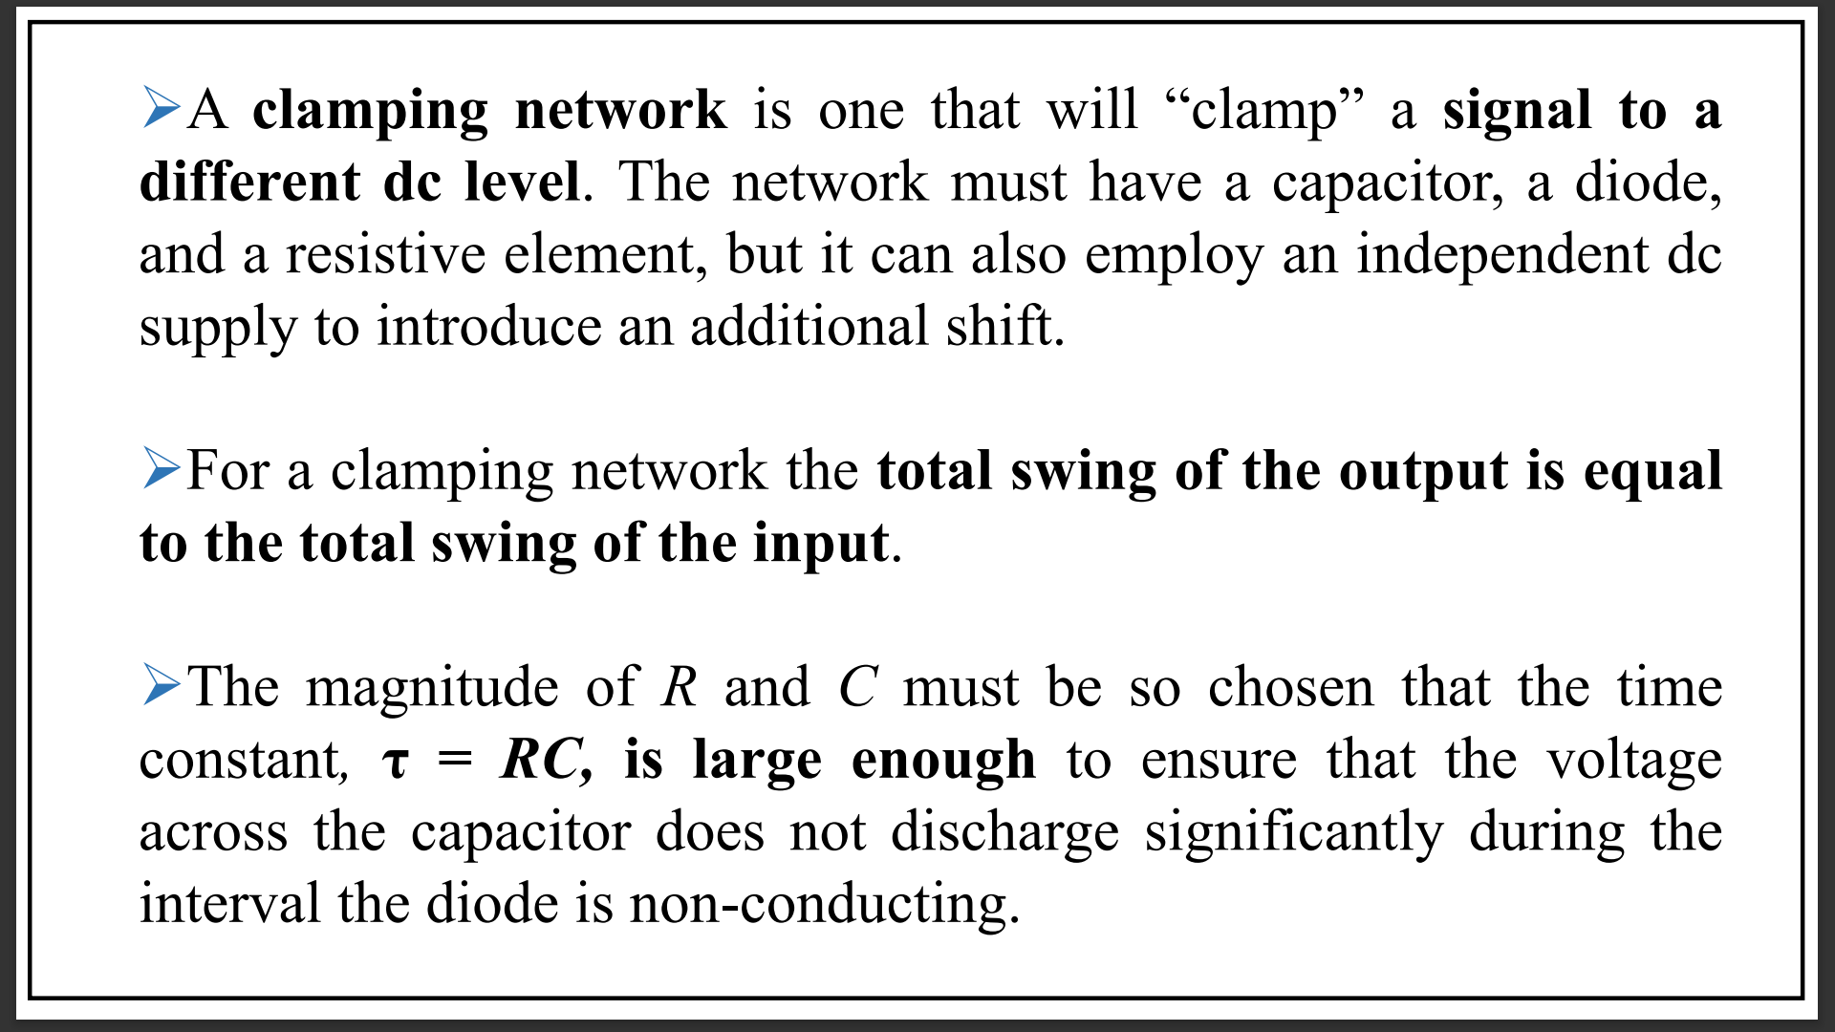
Clamper

Slide 11
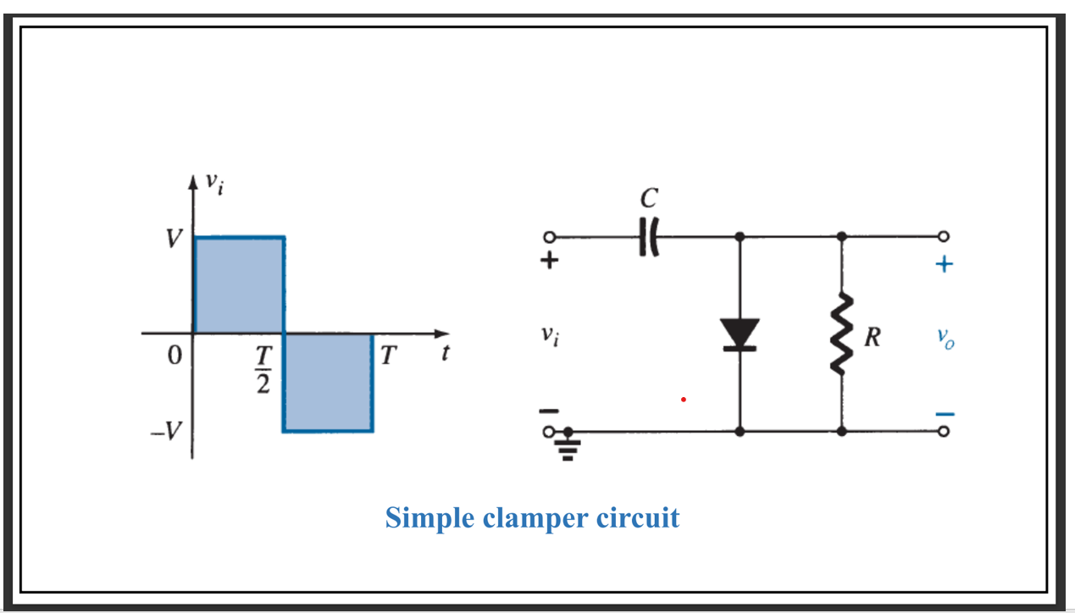
Clamper

Slide 12
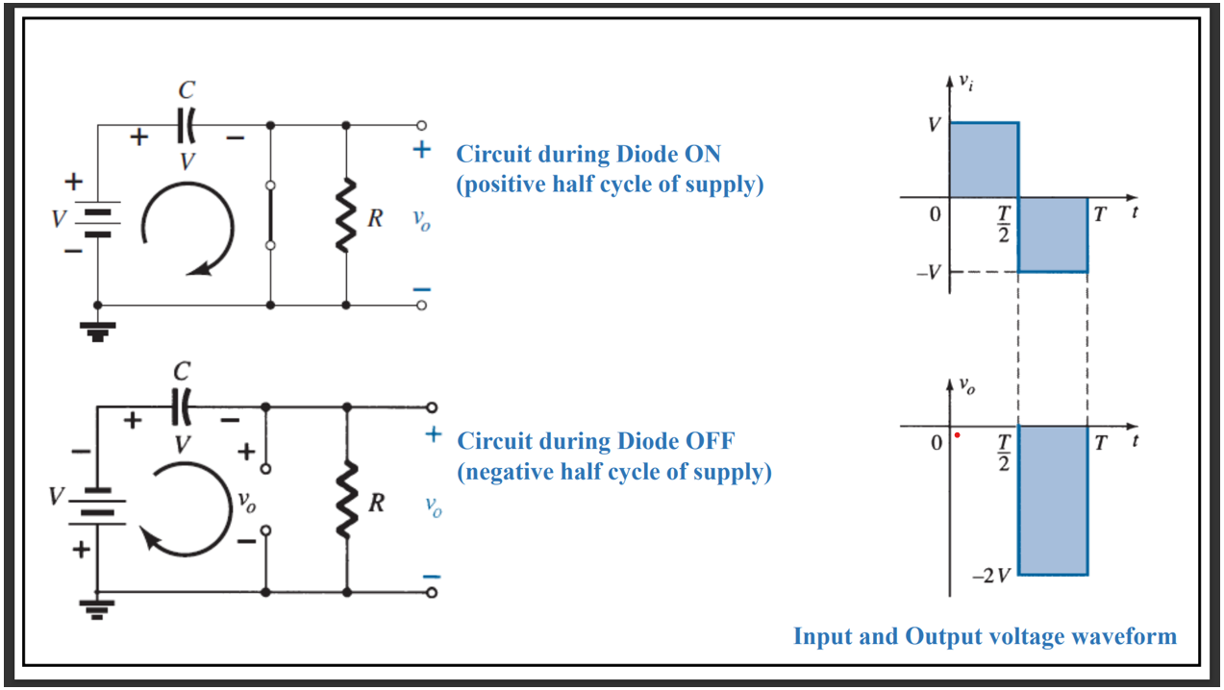
Clamper

Slide 13
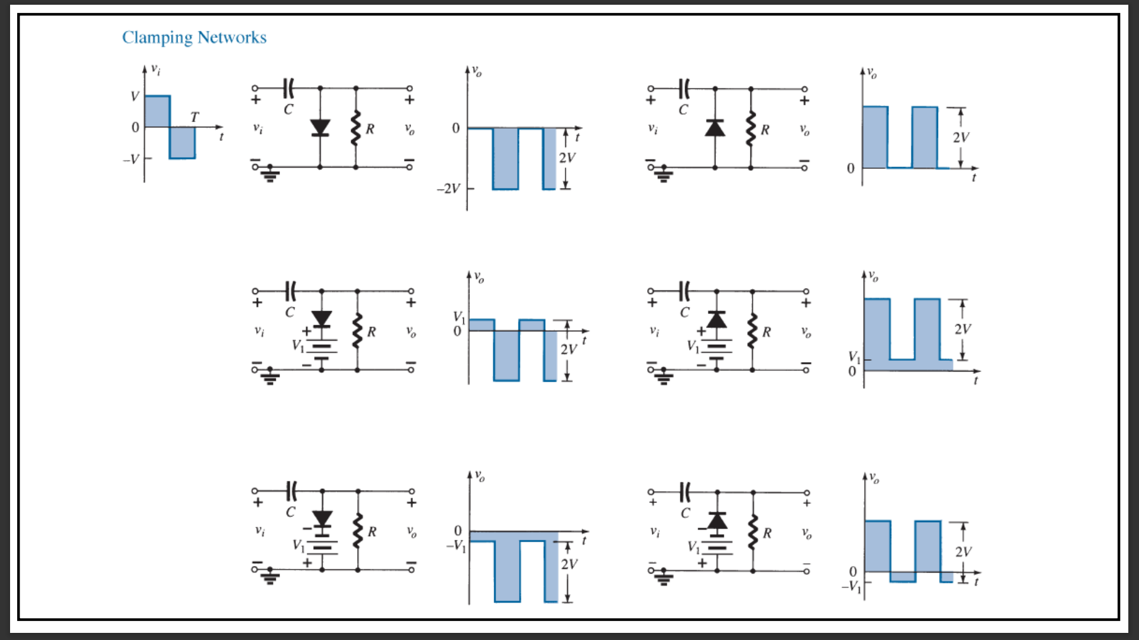
Clamper

Slide 14
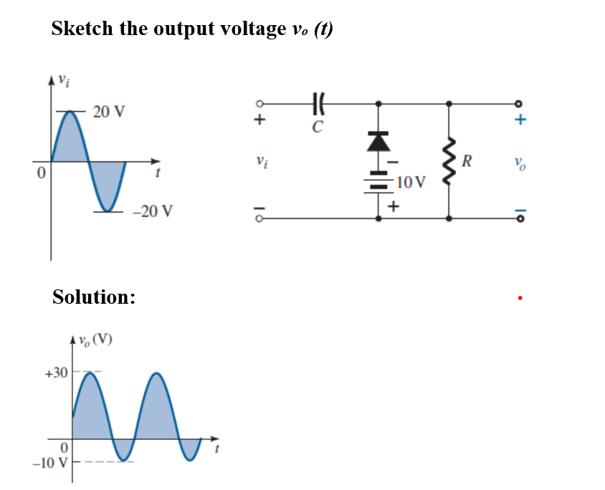
Clamper - numerical

Slide 15
Clamper - numerical

Slide 16
Thank You !!!

